Slide 1

Team 7
Carni, Cortés, Juarez, Lucente, Rosen, Sevilla

Slide 2
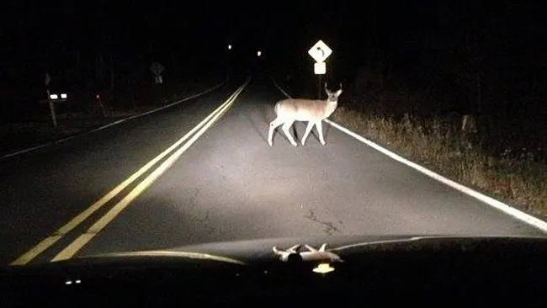
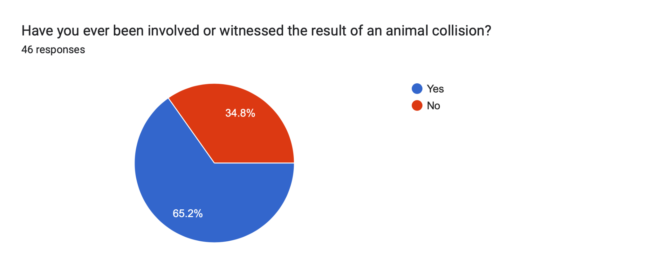

Problem
There is a need to reduce the number of vehicle collisions with wildlife to prevent injuries and damages.
Over 4,000 animal-vehicles collisions in United States everyday [1]
65% of the 45 drivers we interviewed and surveyed have witnessed animal collisions. [2]
Millions of animal deaths due to auto collisions, resulting in $8.4 billion in damages every year. [3]
[1] Utah State University, The Center for Growth and Opportunity. Wildlife Crossing Ahead: Costs and Benefits of Avoided Collisions”. https://www.thecgo.org/research/wildlife-crossing-ahead-costs-and-benefits-of-avoided-collisions/
[2] Engineering Innovation Team 7 “Animal Collision Survey”
[3] The Pew Charitable Trusts. “Wildlife-Vehicle Collisions Are a Big and Costly Problem and Congress Can Help”. https://pew.org/2R695Md
PSF

Slide 3
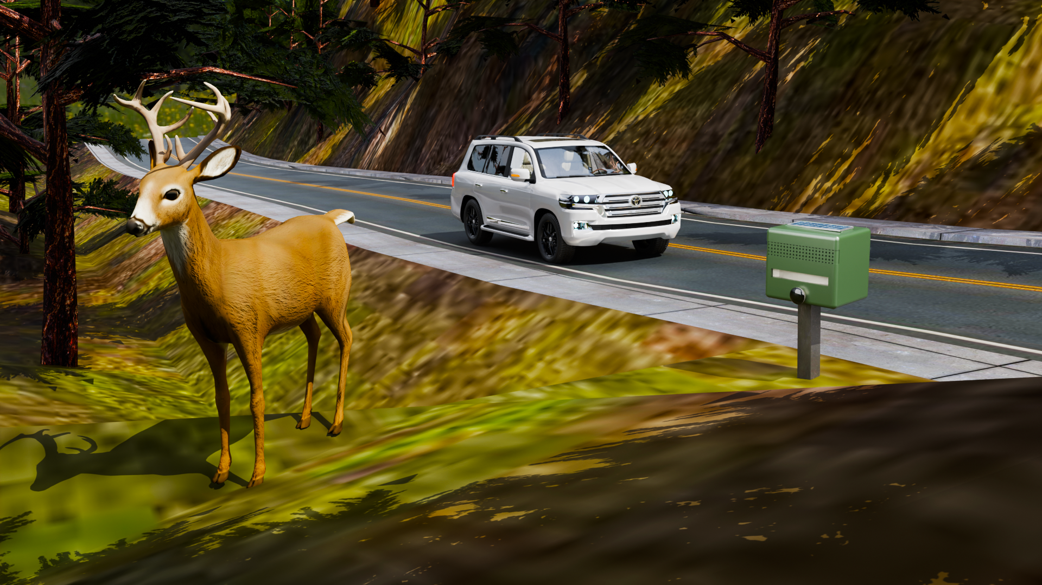
WildSight
Compact Solar-Powered Repellent Device
Advanced AI Vision Technology
Highly Effective Frequencies
Supports Pre-existing Solutions
Concentrates to Minimize
Redundant Detection
Versatile Design
PSF

Slide 4
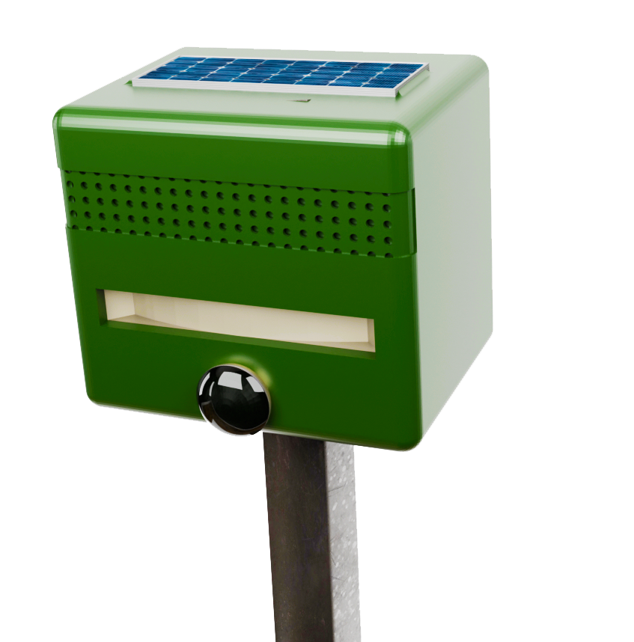
WildSight
Solar Panel
Speaker
Weatherproof Case
Motion Sensor
Camera
Ground Stake
PSF

Slide 5
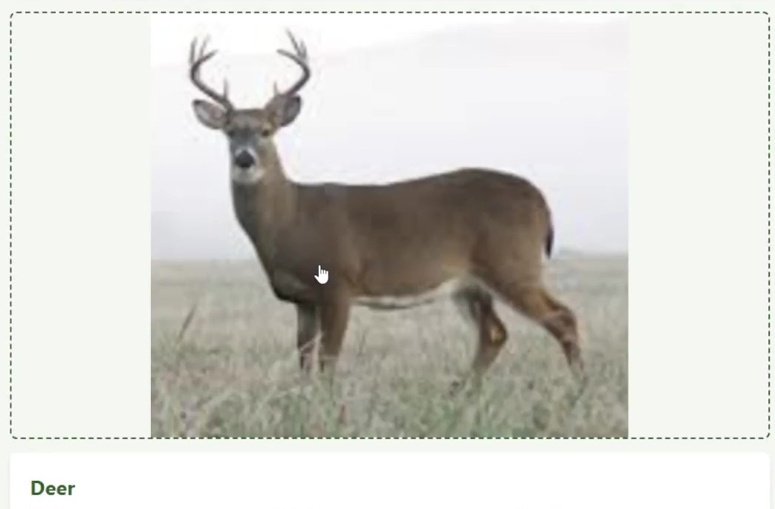
Hearing Ranges of Animals
Animal | Hearing Range (Hz) [4][5] | Emitted Frequency (Hz)
Armadillo | 500-48,000 | 46,000
Cats | 55-79,000 | 75,000
Deer | 250-30,000 | 28,000
Dogs | 64 - 44,000 | 42,000
Possum | 500-64,000 | 60,000
Raccoon | 100-40,000 | 38,000
Squirrels | 113-49,000 | 45,000
[4] Columbia Hearing. “How Humans & Animals Hear”. https://columbiamohearingcenter.com/how-humans-animals-hear/
[5] Louisiana State University. “How Well Do Dogs and Other Animals Hear?” https://www.lsu.edu/deafness/HearingRange.html

Slide 6
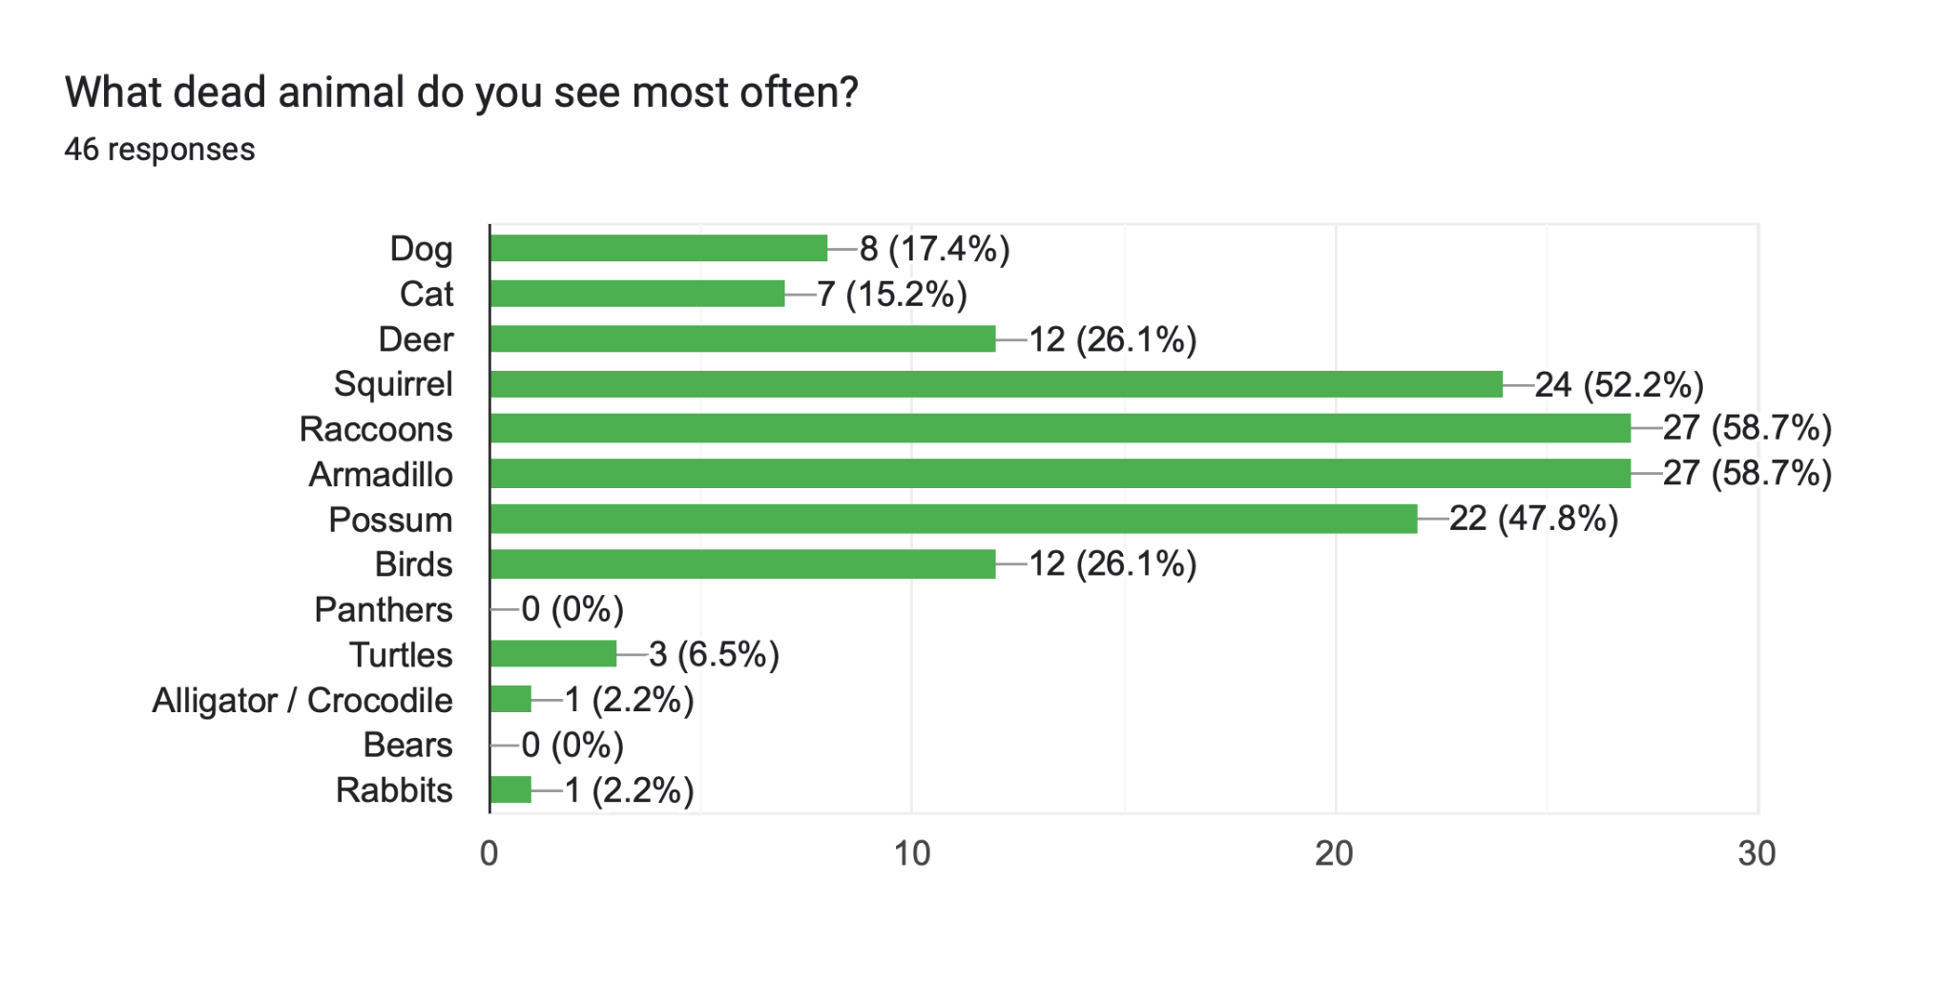
Animals Involved in Collisions
[2] Engineering Innovation Team 7 “Animal Collision Survey”

Slide 7
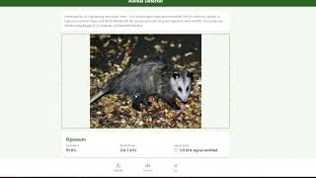
AI Prototype
Video: https://youtu.be/f40RR7-SYpQ?si=P7ohVKh_F4ftU0Hz
Demo: https://animal-detector.gptengineer.run/

Slide 8
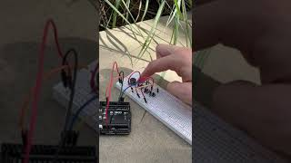
Device Prototype
https://youtube.com/shorts/a0Vg4vuzcJ4?feature=share

Slide 9
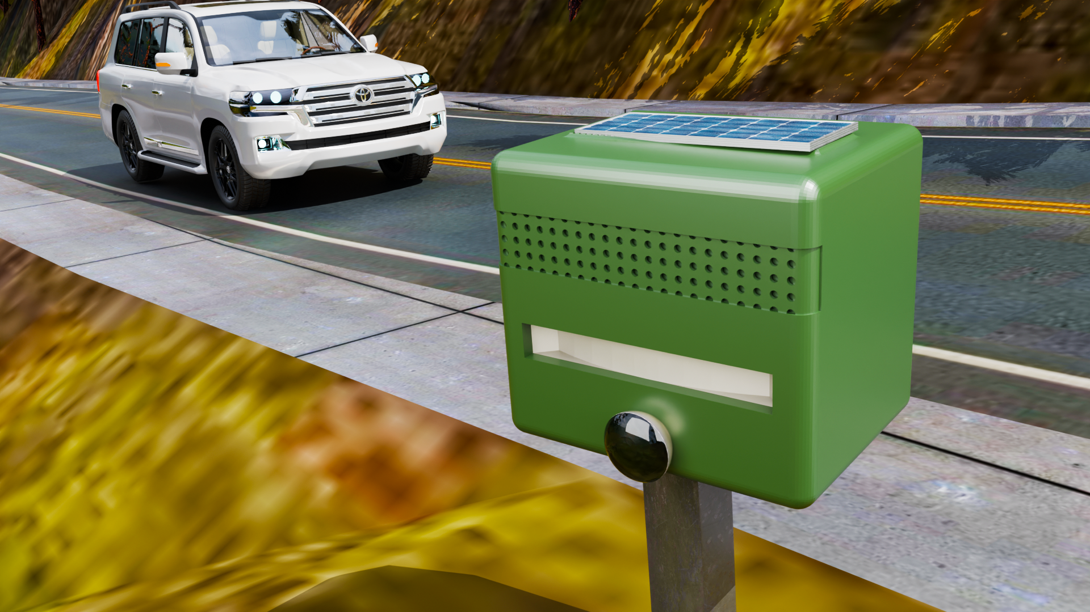
Sustainability
Serviceable & Sustainable
Suitable for use in remote areas
Weather-Resistant
Annual Maintenance

Slide 10
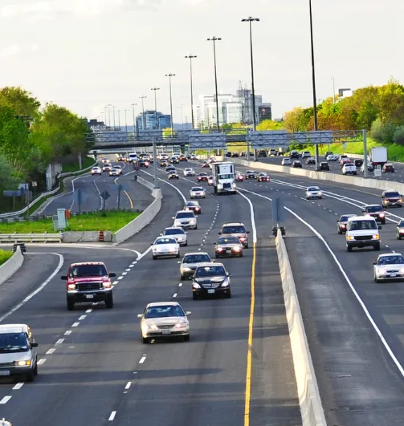
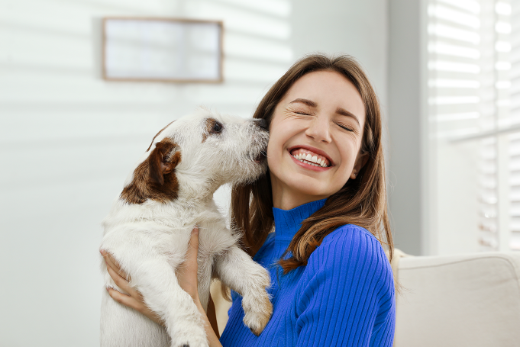


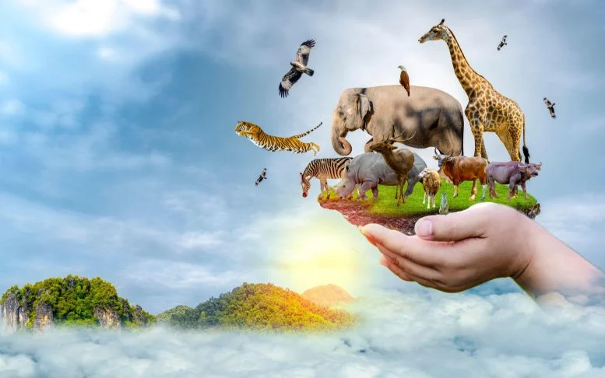
Value to Stakeholders
Drivers
Pet Owners
Insurance Companies
Government Agencies
Animal Conservationists
Notes:
Drivers
Safer roads and reduced collision risks.
Animal Conservationists
Improved wildlife safety and population preservation.
Government Agencies
Fewer wildlife injuries and reduced costs related to collisions.
Insurance Agencies
Decreased claims due to fewer accidents.
Pet Owners
Safer environments for domestic animals.

Slide 11
Target Market
U.S Driving Market & DOT
239.2 million people [6]
3.9 million miles of roadway [7]
Florida DOT & State Legislators
160 Legislators [8]
267,793 miles of roadways[9]
Alachua county DOT
Road system consists of over 640 miles of paved roads and 240 miles of graded roads. [10]
[6] https://hedgescompany.com/blog/2024/01/number-of-licensed-drivers-us/#:~:text=More%20than%20nine%20out%20of,who%20drive%20in%20the%20US.
[7] https://www.fhwa.dot.gov/ohim/onh00/our_ntns_hwys.pdf
[8]https://ballotpedia.org/Florida_State_Legislature
[9] https://www.fhwa.dot.gov/policyinformation/statistics/2008/hm60.cfm
[10] https://alachuacounty.us/Depts/PW/Roads/Pages/Road%20and%20Bridge.aspx
Notes:
https://journals.plos.org/plosone/article?id=10.1371/journal.pone.0098613
https://www.fhwa.dot.gov/ohim/onh00/our_ntns_hwys.pdf

Slide 12
Because saving lives, human and animal, shouldn’t be optional.

